Slide 1
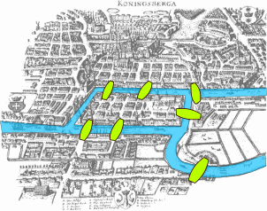
Introduction to Graphs

Slide 2
This Lecture
In this part we will study some basic graph theory.
Graph is a useful concept to model many problems in computer science.
Seven bridges of Konigsberg
Graphs, degrees
Isomorphism
Path, cycle, connectedness
Tree
Eulerian cycle
Directed graphs

Slide 3
Seven Bridges of Königsberg
Is it possible to walk with a route that crosses each bridge exactly once?

Slide 4
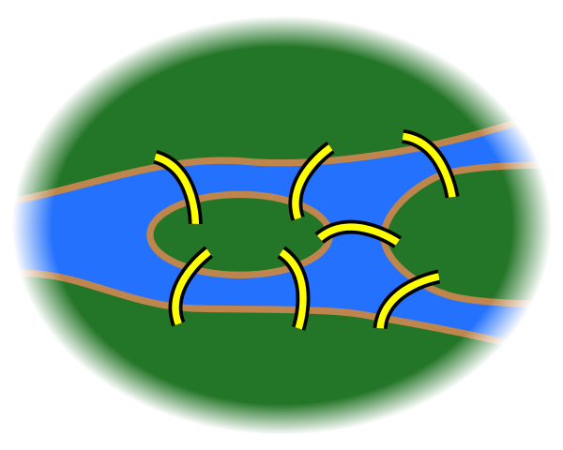
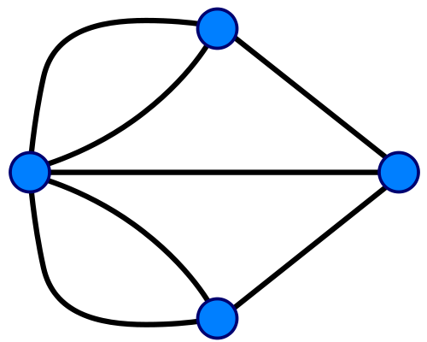
Seven Bridges of Königsberg
Forget unimportant details.
Forget even more.

Slide 5
A Graph
An edge
(or a line)
A vertex
(or a node,
or a point)
e6
d
We write:
e2 = (b,c);
We also write:
e2 = b c
e7
e5
e4
c
a
e3
e2
e1
b
So, what is the “Seven Bridges of Königsberg” problem now?
To find a walk that visits each edge exactly once.

Slide 6
d
d
e7
e6
e7
e6
e5
e5
a
a
c
c
e4
e4
e3
e3
e1
e1
e2
e2
b
b
e6
d
e5
e7
e4
c
a
e3
e2
e1
b

Slide 7
Euler’s Solution
Is it possible to walk with a route that crosses each bridge exactly once?
Question: Is it possible to find a walk that visits each edge exactly once.
e6
d
e7
e5
e4
v
c
a
e3
e2
e1
b
Suppose there is such a walk, there is a starting point and an endpoint point.
For every “intermediate” point v, there must be the same number of
incoming and outgoing edges, and so v must have an even number of edges.

Slide 8
Euler’s Solution
Question: Is it possible to find a walk that visits each edge exactly once.
e6
d
So, at most two vertices can
have odd number of edges.
e7
e5
e4
In this graph, every vertex has only an odd number of edges,
and so there is no walk which visits each edge exactly one.
c
a
e3
e2
e1
b
Suppose there is such a walk, there is a starting point and an endpoint point.
For every “intermediate” point v, there must be the same number of
incoming and outgoing edges, and so v must have an even number of edges.

Slide 9
Euler’s Solution
So Euler showed that the “Seven Bridges of Königsberg” has no solution
When is it possible to have a walk that visits every edge exactly once?
Is it always possible to find such a walk if there is
at most two vertices with odd number of edges?

Slide 10
Euler’s Solution
So Euler showed that the “Seven Bridges of Königsberg” has no solution
When is it possible to have a walk that visits every edge exactly once?
Is it always possible to find such a walk if there is
at most two vertices with odd number of edges?
NO!

Slide 11
Euler’s Solution
So Euler showed that the “Seven Bridges of Königsberg” has no solution
When is it possible to have a walk that visits every edge exactly once?
Is it always possible to find such a walk if the graph is “connected”
and there are at most two vertices with odd number of edges?
YES!

Slide 12
Euler’s Solution
So Euler showed that the “Seven Bridges of Königsberg” has no solution
When is it possible to have a walk that visits every edge exactly once?
Eulerian path
Euler’s theorem: A graph has an Eulerian path if and only if it is
“connected” and has at most two vertices with an odd number of edges.
This theorem was proved in 1736,
and was regarded as the starting point of graph theory.

Slide 13
This Lecture
Seven bridges of Konigsberg
Graphs, degrees
Isomorphism
Path, cycle, connectedness
Tree
Eulerian cycle
Directed graphs

Slide 14
Types of Graphs
Simple Undirected Graph
Directed Graph
Multi-Graph
Eulerian path problem

Slide 15
Simple Graphs
a
A graph G=(V,E) consists of:
A set of vertices, V
A set of undirected edges, E
b
f
c
V(G) = {a,b,c,d,e,f}
E(G) = {ad,af,bd,be,cd,ce,df}
e
d
G
Two vertices a,b are adjacent (neighbours) if the edge ab is present.

Slide 16
Vertex Degrees
An edge uv is incident on
the vertex u and the vertex v.
a
b
f
The neighbour set N(v) of a vertex v
is the set of vertices adjacent to it.
c
e.g. N(a) = {d,f}, N(d) = {a,b,c,f}, N(e) = {b,c}.
e
d
degree of a vertex = # of incident edges
e.g. deg(d) = 4, deg(a)=deg(b)=deg(c)=deg(e)=deg(f)=2.
the degree of a vertex v = the number of neighbours of v?
For multigraphs, NO.
For simple graphs, YES.

Slide 17
Degree Sequence
Is there a graph with degree sequence (2,2,2)?
YES.
Is there a graph with degree sequence (3,3,3,3)?
YES.
Is there a graph with degree sequence (2,2,1)?
NO.
2
2
1
Is there a graph with degree sequence (2,2,2,2,1)?
NO.
Where to go?
What’s wrong with these sequences?

Slide 18
Handshaking Lemma
For any graph, sum of degrees = twice # edges
Lemma.
Corollary.
Sum of degree is an even number.
Number of odd degree vertices is even.
Examples. 2+2+1 = odd, so impossible.
2+2+2+2+1 = odd, so impossible.

Slide 19
Handshaking Lemma
Lemma.
Proof.
Each edge contributes 2 to the sum on the right.
Q.E.D.
Question. Given a degree sequence, if the sum of degree is even,
is it true that there is a graph with such a degree sequence?
For simple graphs, NO, consider the degree sequence (3,3,3,1).
(3,3,3,3)
For multigraphs (with self loops), YES!
A Self loop adds
two degrees!
(2,2,2)
(2,2,3,1)
(4,4,3,1)
(3,3,3,1)

Slide 20
This Lecture
Seven bridges of Konigsberg
Graphs, degrees
Isomorphism
Path, cycle, connectedness
Tree
Eulerian cycle
Directed graphs

Slide 21
Same Graphs?
Same graph (different drawings)
257
122
257
122
145
99
306
67
99
67
306
145
Same graph (different labels)
257
122
145
Albert
Grant
Sharat
306
67
Christos
Sonya
99
Jessica

Slide 22
Graph Isomorphism
All that matters is the connections.
Graphs with the same connections are isomorphic.
Informally, two graphs are isomorphic if they are the same after renaming.
Graph isomorphism has applications like checking fingerprint, testing molecules…

Slide 23
Are These Isomorphic?
one-to-one mapping
Hay
Dog
Pig
Corn
Cow
Cat
Beef
Tuna
f (Dog) = Beef
f (Cat) = Tuna
f (Cow) = Hay
f (Pig) = Corn

Slide 24
Are These Isomorphic?
one-to-one mapping
Hay
Dog
Pig
Corn
Cow
Cat
Beef
Tuna
Edge preserved?
YES!
If there is an edge in the original graph, there is an edge after the mapping.

Slide 25
Are These Isomorphic?
one-to-one mapping
Hay
Dog
Pig
Corn
Cow
Cat
Beef
Tuna
Non-Edge preserved?
YES!
If there is no edge in the original graph, there is no edge after the mapping.

Slide 26
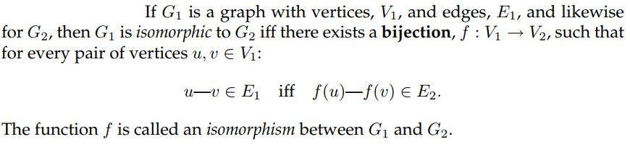
Graph Isomorphism
uv is an edge in G1
f(u)f(v) is an edge in G2
If G1 and G2 are isomorphic, do they have the same number of vertices?
If G1 and G2 are isomorphic, do they have the same number of edges?
If G1 and G2 are isomorphic, do they have the same degree sequence?
If G1 and G2 have the same degree sequence, are they isomorphic?
YES
YES
YES
NO

Slide 27
Checking Graph Isomorphism
How to show two graphs are isomorphic?
Find a mapping and show that it is edge-preserving as well as non-edge preserving.
How to show two graphs are non-isomorphic?
Find some isomorphic-preserving properties
which is satisfied in one graph but not the other.
Non-isomorphic
degree 2
all degree 3

Slide 28
Which is isomorphic to G1?
Testing graph isomorphism is not easy –
No known general method to test graph ismorphism
much more efficient than checking all possibilities.

Slide 29
This Lecture
Seven bridges of Konigsberg
Graphs, degrees
Isomorphism
Path, cycle, connectedness
Tree
Eulerian cycle
Directed graphs

Slide 30
Paths
Path: sequence of adjacent vertices
(
)

Slide 31
Simple Paths
Simple Path: all vertices different
(
)

Slide 32
Connectedness
Vertices v, w are connected if and only if
there is a path starting at v and ending at w.
A graph is connected iff every pair of vertices are connected.
Every graph consists of separate connected pieces called connected components
13
12
26
16
66
E17
E25
10
8
4
3 connected components
So a graph is connected if and only if it has only 1 connected component.

Slide 33
Cycles
A cycle is a path that begins and ends with same vertex.
v
a
w
b
cycle: v ···b ···w ···w ···a ···v
also: a ···v ···b ···w ···w ···a

Slide 34
Simple Cycles
A simple cycle is a cycle that doesn’t cross itself
In a simple cycle, every vertex is of degree exactly 2.
v
w
cycle: v ···w ···v
also: w ···v ···w

Slide 35
Shortest Paths
A path between u and v is a shortest path
if among all u-v paths it uses the minimum number of edges.
Is a shortest path between two vertices always simple?
Idea: remove the cycle will make the path shorter.
c
u
v

Slide 36
This Lecture
Seven bridges of Konigsberg
Graphs, degrees
Isomorphism
Path, cycle, connectedness
Tree
Eulerian cycle
Directed graphs

Slide 37
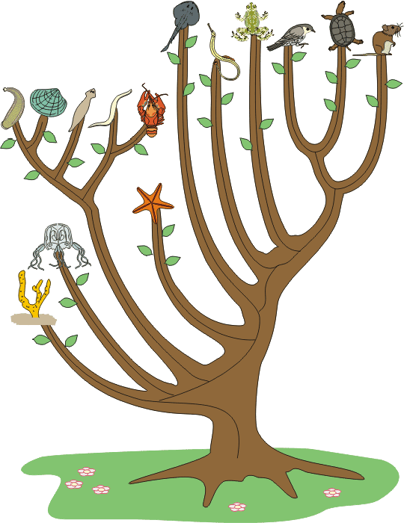
Tree
Graphs with no cycles?
A forest.
Connected graphs with no cycles?
A tree.

Slide 38
More Trees
leaf
leaf
A leaf is a vertex of degree 1.
More leaves.
Even more leaves.

Slide 39
Tree Characterization by Path
Definition. A tree is a connected graph with no cycles.
Can there be no path between u and v?
NO
Can there be more than one simple path between u and v?
NO
This will create cycles.
u
v
Claim. In a tree, there is a unique simple path between every pair of vertices.

Slide 40
Tree Characterization by Number of Edges
Definition. A tree is a connected graph with no cycles.
Can a tree have no leaves?
NO
Then every vertex has degree at least 2.
Go to unvisited edges as long as possible.
Cannot reach an already visited vertex…
unless there is a cycle.

Slide 41
Tree Characterization by Number of Edges
Definition. A tree is a connected graph with no cycles.
Can a tree have no leaves?
NO
How many edges does a tree have?
n-1?
We usually use n to denote the number of vertices,
and use m to denote the number of edges in a graph.

Slide 42
Tree Characterization by Number of Edges
Definition. A tree is a connected graph with no cycles.
Can a tree have no leaves?
NO
How many edges does a tree have?
n-1?
v
Look at a leaf v.
Is T-v a tree?
YES
Can T-v has a cycle?
Is T-v connected?
NO
YES
By induction, T-v has (n-1)-1=n-2 edges.
So T has n-1 edges.

Slide 43
Tree Characterizations
Definition. A tree is a connected graph with no cycles.
Characterization by paths:
A graph is a tree if and only if
there is a unique simple path between every pair of vertices.
Characterization by number of edges:
A graph is a tree if and only if it is connected and has n-1 edges.
(We have only proved one direction.
The other direction is similar and can be proved easily.)

Slide 44
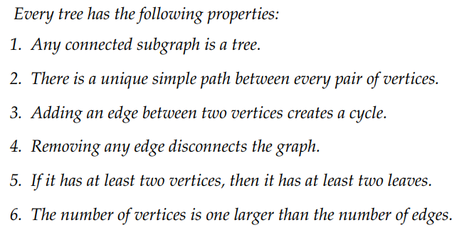

Slide 45
Any connected subgraph of a tree is a tree.
A simple cycle in a subgraph is also a simple cycle in the whole graph
so any subgraph of an acyclic graph must also be acyclic.
If the subgraph is also connected, then by definition, it is a tree.

Slide 46
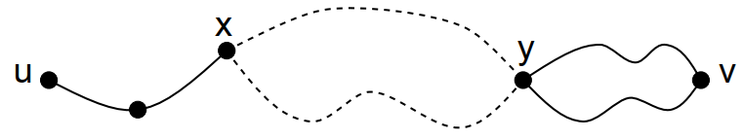
There is a unique simple path between every pair of vertices in a tree
There is at least one path, and hence one simple path, between every pair of vertices, because the graph is connected.
Suppose that there are two different simple paths between vertices u and v.
Beginning at u, let x be the first vertex where the paths diverge, and let y be the next vertex they share.
Then there are two simple paths from x to y with no common edges, which defines a simple cycle.
This is a contradiction, since trees are acyclic.
Therefore, there is exactly one simple path between every pair of vertices.

Slide 47
Adding an edge between two vertices in a tree creates a cycle.
Consider a pair of vertices u,v.
There is a unique path between u and v
An additional edge u—v together with the unique path between u and v forms a simple cycle.
v
u

Slide 48
Removing any edge from a tree disconnects the graph.
Suppose that we remove edge u—v.
Since the tree contained a unique path between u and v, that path must have been u—v.
Therefore, when that edge is removed, no path remains,
and so the graph is not connected.

Slide 49
In a tree with at least two vertices, there are at least two leaves.
Let v₁, . . . , v_{m} be the sequence of vertices on a longest simple path in the tree.
Then m ≥ 2, since a tree with two vertices must contain at least one edge.
There cannot be an edge v₁—v_{i} for 2 < i ≤ m; otherwise, vertices v₁, . . . , v_{i} would from a simple cycle.
Furthermore, there cannot be an edge u—v₁ where u is not on the path; otherwise, we could make the path longer, contradicting hypothesis of a longest path.
Therefore, the only edge incident to v₁ is v₁—v₂, which means that v₁ is a leaf.
By a symmetric argument, v_{m} is a second leaf.
u
leaf
leaf
v₁
v₂
v_{m-1}
v_{m}
v_{i}

Slide 50
The number of vertices is one larger than the number of edges.
We use induction on the number of vertices.
For a tree with a single vertex, the claim holds: it has no edge and 0 + 1 = 1 vertex.
Now suppose that the claim holds for all n-vertex trees and consider an (n+1)-vertex tree, T.
Let v be a leaf of the tree.
You can verify that deleting a vertex of degree 1 (and its incident edge) from any connected graph leaves a connected subgraph.
So by A, deleting v and its incident edge gives a smaller tree. [A. Any connected subgraph of a tree is a tree.]
Now we take induction hypothesis we assume that this smaller tree has one more vertex than edge.
If we re-attach the vertex, v, and its incident edge, then the equation still holds because the number of vertices and number of edges both increase by 1.
Thus, the claim holds for T and, by induction, for all trees.
v

Slide 51
This Lecture
Seven bridges of Konigsberg
Graphs, degrees
Isomorphism
Path, cycle, connectedness
Tree
Eulerian cycle
Directed graphs

Slide 52
Eulerian Graphs
Euler’s theorem: A graph has an Eulerian path if and only if it is
connected and has at most two vertices with an odd number of edges.
Can a graph have only 1
odd degree vertex?
Odd degree vertices.
Euler’s theorem: A connected graph has an Eulerian path if and only if
it has zero or two vertices with odd degrees.
Proof by induction. Focus on the case of Eulerian cycle.

Slide 53
Eulerian Cycle
Euler’s theorem: A connected graph has an Eulerian cycle if and only if
every vertex is of even degree.
First we find an Eulerian cycle in the below example.

Slide 54
Eulerian Cycle
Euler’s theorem: A connected graph has an Eulerian cycle if and only if
every vertex is of even degree.
Note that the edges can be partitioned into five simple cycles.
Vertices of the same color represent the same vertices.

Slide 55
Eulerian Cycle
Euler’s theorem: A connected graph has an Eulerian cycle if and only if
every vertex is of even degree.
The idea is that we can construct an Eulerian cycle by adding cycle one by one.
1
2
First transverse the first cycle.

Slide 56
Eulerian Cycle
Euler’s theorem: A connected graph has an Eulerian cycle if and only if
every vertex is of even degree.
The idea is that we can construct an Eulerian cycle by adding cycle one by one.
1
6
2
3
5
4
Then transverse the second cycle.

Slide 57
Eulerian Cycle
Euler’s theorem: A connected graph has an Eulerian cycle if and only if
every vertex is of even degree.
How to deal with the third cycle?
9
1
10
2
6
8
3
5
7
4
We can “detour” to the third cycle before finishing the second cycle.

Slide 58
Eulerian Cycle
Euler’s theorem: A connected graph has an Eulerian cycle if and only if
every vertex is of even degree.
We use the same idea to deal with the fourth cycle
13
1
14
10
2
6
12
3
5
11
9
7
4
8
We can “detour” to the fourth cycle at an “intersection point”.

Slide 59
Eulerian Cycle
Euler’s theorem: A connected graph has an Eulerian cycle if and only if
every vertex is of even degree.
15
16
12
13
1
14
10
9
14
2
6
12
10
3
5
11
9
13
11
7
4
8
We can “insert” the fifth cycle at an “intersection point”.

Slide 60
Eulerian Cycle
Euler’s theorem: A connected graph has an Eulerian cycle if and only if
every vertex is of even degree.
15
1
16
12
9
2
6
14
10
3
5
13
11
7
4
8
So we have an Eulerian cycle of this example

Slide 61
Eulerian Cycle
Euler’s theorem: A connected graph has an Eulerian cycle if and only if
every vertex is of even degree.
1
15
16
12
9
2
3
5
6
14
10
13
11
7
4
8
15
1
9
16
12
13
3
5
11
6
14
10
2
7
4
8
So we have an Eulerian cycle of this example

Slide 62
Idea
In general, if we have a “partial Eulerian cycle” C*,
and it intersects with a cycle C on a vertex v,
then we can extend the “partial Eulerian cycle” C* to include C.
C*
C
v
First follow C* until we visit v, then follow C until we go back to v,
and then follow C* from v to the end.

Slide 63
Proof
We have informally proved the following claim in the previous slides.
Claim 1. If the edges of a connected graph can be partitioned
into simple cycles, then we can construct an Eulerian cycle.
Euler’s theorem: A connected graph has an Eulerian cycle if and only if
every vertex is of even degree.
We can prove Euler’s theorem if we can prove the following claim.
Claim 2. If every vertex is of even degree, then
the edges can be partitioned into simple cycles.

Slide 64
Partitioned into Simple Cycles
Claim 2. If every vertex is of even degree, then
the edges can be partitioned into simple cycles.
First we can find one cycle by the same idea as before.
Start from any vertex.
Go to unvisited edges as long as possible.
Cannot get stuck before we find a cycle,
because every vertex has degree >= 2.

Slide 65
Partitioned into Simple Cycles
Claim 2. If every vertex is of even degree, then
the edges can be partitioned into simple cycles.

Slide 66
Partitioned into Simple Cycles
Claim 2. If every vertex is of even degree, then
the edges can be partitioned into simple cycles.

Slide 67
Partitioned into Simple Cycles
Claim 2. If every vertex is of even degree, then
the edges can be partitioned into simple cycles.

Slide 68
Partitioned into Simple Cycles
Claim 2. If every vertex is of even degree, then
the edges can be partitioned into simple cycles.

Slide 69
Partitioned into Simple Cycles
Claim 2. If every vertex is of even degree, then
the edges can be partitioned into simple cycles.

Slide 70
Partitioned into Simple Cycles
Claim 2. If every vertex is of even degree, then
the edges can be partitioned into simple cycles.

Slide 71
Partitioned into Simple Cycles
Claim 2. If every vertex is of even degree, then
the edges can be partitioned into simple cycles.

Slide 72
Partitioned into Simple Cycles
Claim 2. If every vertex is of even degree, then
the edges can be partitioned into simple cycles.

Slide 73
Partitioned into Simple Cycles
Claim 2. If every vertex is of even degree, then
the edges can be partitioned into simple cycles.

Slide 74
Partitioned into Simple Cycles
Claim 2. If every vertex is of even degree, then
the edges can be partitioned into simple cycles.

Slide 75
Partitioned into Simple Cycles
Claim 2. If every vertex is of even degree, then
the edges can be partitioned into simple cycles.
Proof. Let C be a simple cycle.
Remove the edges in C from the graph G and call the new graph G’.
So the degree of each vertex is either unchanged or decreased by two.
So every vertex of the graph G’ is still of even degree.
Note that G’ has fewer edges than G.
By induction, G’ can be partitioned into simple cycles C₁, C₂, …, C_{k}.
So the original graph G can be partitioned into simple cycles, C, C₁, C₂, …, C_{k}.

Slide 76
Proof
We have informally proved the following claim in the previous slides.
Claim 1. If the edges of a connected graph can be partitioned
into simple cycles, then we can construct an Eulerian cycle.
We proved the following claim by induction.
Claim 2. If every vertex is of even degree, then
the edges can be partitioned into simple cycles.
So now we have proved Euler’s theorem.
Euler’s theorem: A connected graph has an Eulerian cycle if and only if
every vertex is of even degree.

Slide 77
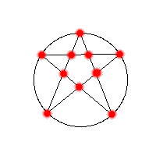
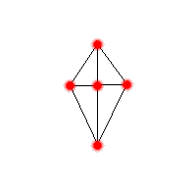
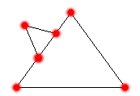
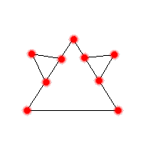
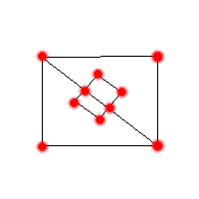
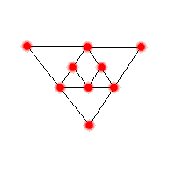
(Eulerian) Paths, Cycles or Neither?

Slide 78
This Lecture
Seven bridges of Konigsberg
Graphs, degrees
Isomorphism
Path, cycle, connectedness
Tree
Eulerian cycle
Directed graphs

Slide 79
Directed Graphs
a
A directed graph G=(V,A) consists of:
A set of vertices, V
A set of directed edges (arcs), A
b
f
c
V(G) = {a,b,c,d,e,f}
A(G) = {da, fa, db, eb, dc, ec, fd}
e
d
G
For an arc uv, we say u is the tail of the arc and v is the head of the arc.
Also, we say v is an out-neighbor of u, and u is an in-neighbor of v.
u
v

Slide 80
In-Degrees and Out-Degrees
a
b
The out-degree of a vertex v is the number of
arcs with v being tail; similarly, the in-degree of
a vertex v is the number of arcs with v being head.
f
c
e
E.g. the indegree of a is 2 and the outdegree of a is 0,
the indegree of d is 1 and the outdegree of d is 3.
d
G

Slide 81
Directed Paths
Informally, a directed path is a path that follows directions.
Directed Path: sequence of vertices v₁, v₂, …, v_{k} such that there is an
arc from v_{i} to v_{i+1} for all 1 <= i <= k-1.
Simple Directed Path: a directed path with no repeated vertices.

Slide 82
Directed Cycles
A directed cycle is a directed path that begins and ends with same vertex.
v
a
w
b
cycle: v ···b ···w ···w ···a ···v
also: a ···v ···b ···w ···w ···a
A simple directed cycle is a directed cycle with no repeated vertices except the last.

Slide 83
Eulerian Problem in Directed Graphs
Given a directed graph, when is it possible to have a directed cycle/path
that visits every arc exactly once?
in# 2
out# 2
in# 1
out# 1
in# 2
out# 2
in# 1
out# 1
in# 1
out# 1
in# 2
out# 2
in# 2
out# 2
in# 2
out# 2
in# 1
out# 1

Slide 84
Eulerian Problem in Directed Graphs
Given a directed graph, when is it possible to have a directed cycle/path
that visits every arc exactly once?
in# 2
out# 2
in# 1
out# 1
in# 2
out# 2
in# 1
out# 1
in# 1
out# 1
in# 2
out# 2
in# 2
out# 2
in# 2
out# 2
in# 1
out# 1
If at each node the number in degree = out degree, then there is an Eulerian circuit
If at one node in degree = out degree +1 and at one other node in degree = out degree -1, and all other nodes have in degree = out degree, then there is an Eulerian path.

Slide 85
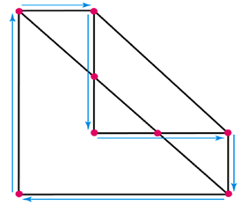
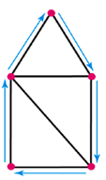



Hamiltonian Cycles
13-B
A Hamiltonian cycle is a path that passes through every vertex of a network exactly once and returns to the starting vertex.
Hamiltonian
Cycle?
Hamiltonian
Cycle?
Hamiltonian
Cycle?

Slide 86
13-B
Which path is a Hamilton cycle?
a)
b)
c)
d)
A
D
B
C

Slide 87
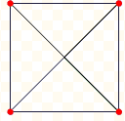

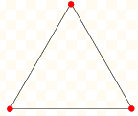
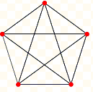
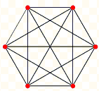
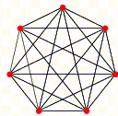
Complete Graph
A complete graph is a graph in which each pair of graph vertices is connected by an edge.
K₂
K₃
K₄
K₅
K₆
K₇

Slide 88
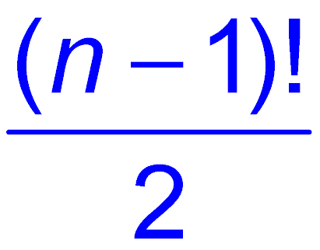
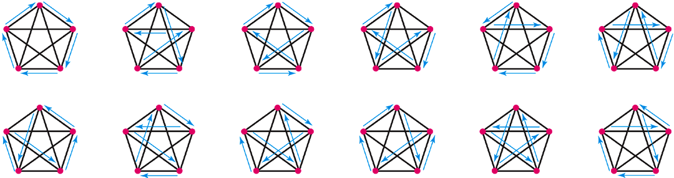
Hamiltonian Cycles in Complete Graphs
The number of Hamiltonian Cycles in a complete graph of order n is .
The twelve Hamiltonian cycle for a complete graph of order 5.

Slide 89

Proof:
There are n! different ways of picking the vertices of G in some order. Hence there are n! ways of building such a Hamiltonian Cycle.
Not all these are different, though. On any such cycle, there are:
n different places you can start;
2 different directions you can travel.
So any one of these n! cycles is in a set of 2n cycles which all contain the same set of edges.
So number of distinct Hamiltonian Cycles is:

Slide 90
How many Hamilton circuits are possible in a complete network of order 8?
a) 7!/2
b) 8!/2
c) 8!
d) 9!/2

Slide 91
The Traveling Salesman Problem
The solution to a traveling salesman problem is the shortest path (smallest total of the lengths) that starts and ends in the same place and visits each city once.

